Slide 1


“ARDUINO BASED REAL-TIME VIOLENCE DETECTION SYSTEM” USING DEEP LEARNING
PROJECT VIVA VOCE on 26/02/2025
Presented By
KISHORE.S (211161021)
PRAVIN.B (211161034)
THAMIZHMANI.V (211161052)
VIII – Sem B.Tech AI&DS
Guided By
Dr.S.Ananth,M.E.,MBA.,Ph.D..
HEAD OF THE DEPARTMENT
DEPARTMENT OF ARTIFICIAL INTELLIGENCE AND DATA SCIENCE
MAHENDRA ENGINEERING COLLEGE
(AUTONOMOUS)
MAHENDRAPURI, NAMAKKAL Dt-637 503
26/02/2025
MEC-VIII Sem. AI&DS-Project Work (Phase-II)
Viva Voce-February-2025
1

Slide 2
OVERVIEW
Domain Introduction
Abstract
Existing System and It’s Disadvantages
Proposed System and It’s Advantages
Objective
System Requirements Specification
Data Flow Diagram
Conclusion
Reference
26/02/2025
MEC-VIII Sem. AI&DS-Project Work (Phase-II)
Viva Voce-February-2025
2

Slide 3
DOMAIN INTRODUCTION
Violence Detection
Falls under computer vision and IoT-based surveillance for real-time violence detection.
Helps in automating security monitoring, reducing the need for constant human intervention.
Enhances public safety by identifying violent incidents as they occur.Provides a cost-effective and efficient alternative to manual monitoring.
26/02/2025
MEC-VIII Sem. AI&DS-Project Work (Phase-II)
Viva Voce-February-2025
3

Slide 4
ABSTRACT
The system continuously captures and analyzes video frames in real time using a trained deep learning model to detect violent activities.
Upon detecting violence, the system:
Triggers an alarm to alert nearby individuals.
Records the frames as evidence for further investigation.
Sends instant notifications via IoT to authorities or security personnel.
3.The combination of AI-based vision analysis and IoT connectivity ensures a rapid and effective response to threats.
26/02/2025
MEC-VIII Sem. AI&DS-Project Work (Phase-II)
Viva Voce-February-2025
4

Slide 5
EXISTING SYSTEM
Security personnel must manually analyze video footage, which is time-consuming and inefficient.
There is no automatic alert system, leading to delayed responses to violent incidents.
Evidence retrieval is cumbersome since recordings must be manually checked after an incident occurs
Disadvantages of Existing Systems
Delayed response
Human errors
Inconsistent monitoring
No real-time alerts
Limited scalability
26/02/2025
MEC-VIII Sem. AI&DS-Project Work (Phase-II)
Viva Voce-February-2025
5

Slide 6
PROPOSED SYSTEM
Uses OpenCV and deep learning models to detect violence in real time with high accuracy.
Integrates IoT-based notifications, ensuring instant alerts to security personnel and emergency services.
Works autonomously, reducing reliance on human intervention.
Provides instant threat detection through image classification and motion analysis techniques.Stores video evidence securely, enabling investigations and legal proceedings.
Advantages of the Proposed System
Real-Time Violence Detection
Automated Alert Mechanism
Reduces Human Effort
Evidence Collection & Storage
26/02/2025
MEC-VIII Sem. AI&DS-Project Work (Phase-II)
Viva Voce-February-2025
6

Slide 7
OBJECTIVE
Real-Time Violence Detection – Detect violent activities instantly using AI.
Automated Alert Mechanism – Send real-time alerts via IoT to authorities.
Evidence Collection & Storage – Record and store incidents for investigation.
26/02/2025
MEC-VIII Sem. AI&DS-Project Work (Phase-II)
Viva Voce-February-2025
7

Slide 8

SYSTEM REQUIREMENTS SPECIFICATION
HARDWARE REQUIREMENTS:
Processor : Intel i5 12th Gen, 2.00GHz
RAM : 8GB
Arduino Board
ESP32 Camera
Buzzer
Motion Sensor
SOFTWARE REQUIREMENTS:
Operating System : Windows 11
Software Tool & IDE : Visual Studio Code, Arduino IDE
Language : Python 3.6 or Higher
26/02/2025
MEC-VIII Sem. AI&DS-Project Work (Phase-II)
Viva Voce-February-2025
8

Slide 9
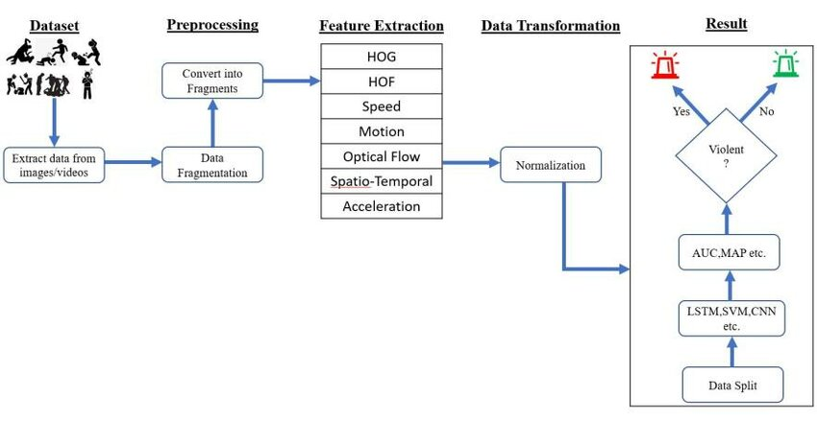
FLOW DIAGRAM
26/02/2025
MEC-VIII Sem. AI&DS-Project Work (Phase-II)
Viva Voce-February-2025
9

Slide 10
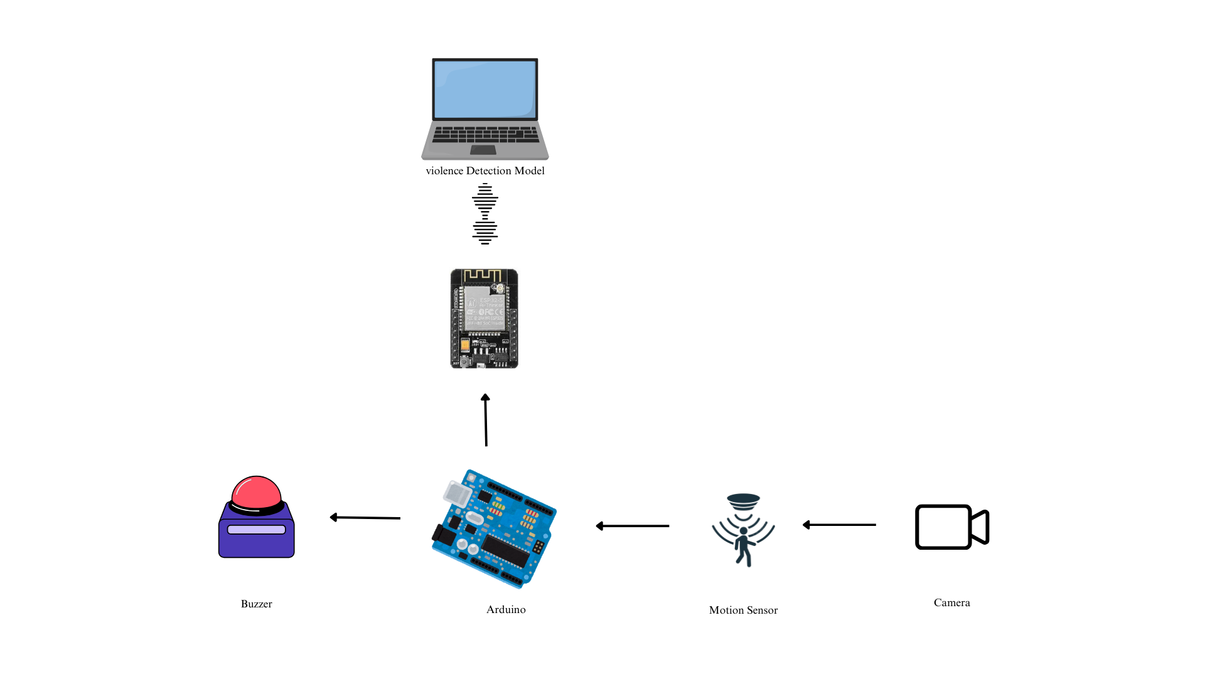
SYSTEM ARCHITECTURE
26/02/2025
MEC-VIII Sem. AI&DS-Project Work (Phase-II)
Viva Voce-February-2025
10

Slide 11
CONCLUSION
The system automates violence detection, reducing reliance on manual surveillance.Provides real-time threat alerts, ensuring quick action and preventing potential harm.
Enhances public safety by combining AI-based detection with IoT-driven alerts.Minimizes human error and improves the efficiency of surveillance systems.Can be deployed in various environments, such as shopping malls, schools, public transport, and offices.
26/02/2025
MEC-VIII Sem. AI&DS-Project Work (Phase-II)
Viva Voce-February-2025
11

Slide 12
REFERENCE
Research Paper: SurveillNet – A Deep Learning-Based Real-Time Violence Detection System Using CCTV Footage. (IEEE Xplore, 2023).
Book: "Computer Vision: Algorithms and Applications" – Richard Szeliski (Springer, 2021).
Journal: Violence Detection in Surveillance Videos Using Deep Learning Approaches. (International Journal of Computer Vision, 2022).
Website: IoT-Based Smart Security Solutions for Public Safety. (Available at: www.sciencedirect.com).
26/02/2025
MEC-VIII Sem. AI&DS-Project Work (Phase-II)
Viva Voce-February-2025
12

Slide 13
Any Queries ?
26/02/2025
MEC-VIII Sem. AI&DS-Project Work (Phase-II)
Viva Voce-February-2025
13

Slide 14
Thank you
26/02/2025
MEC-VIII Sem. AI&DS-Project Work (Phase-II)
Viva Voce-February-2025
14

